Slide 1

Oop/Java/ Android Studio
Y’all boutta learn some shit

Slide 2
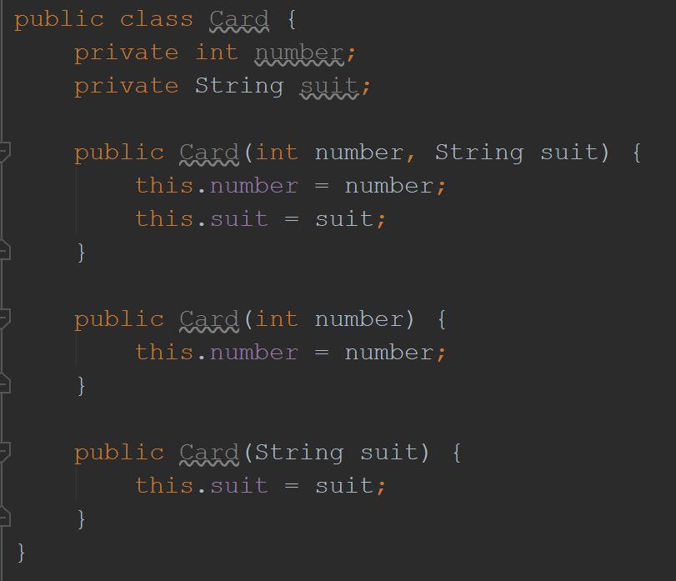
And I oop -
Object Oriented Programming
You can create objects
Each class is its own object
Can create multiple objects
Each object should have constructors, accessors (.get), and mutators (.set)

Slide 3
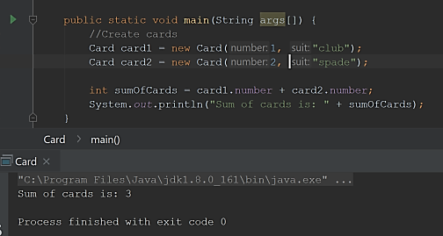
Java as an object oriented language
Main function is how you run all your shit
Always define main as shown
The dot lets you implement functions within the class
i.e. access the constructors, accessors, and mutators
In the example I’m being lazy and not using my accessors – don’t be like me, always create and use .get
Can also print stuff to command line
Idk why the pic looks like shit but just roll with it

Slide 4
Getting the code
Getting Java
Download Java
https://www.java.com/en/download
Check your About Java to make sure it’s downloaded
If you type “java” into command prompt or terminal it will give you an output
Getting Android Studio
Download Android Studio
https://developer.android.com/studio/install
Check out project from version control
Log in to GitHub
Enter the URL for the code
https://github.com/erinjhacker/ELEC490.git
Project should open on it’s own but if it doesn’t just go to location you saved it and open it from there
Getting Git
Download it
Helpful links/tutorial at https://git-scm.com/book/en/v2/Getting-Started-Installing-Git
If you type “git” into command prompt or terminal it will give you an output

Slide 5
What is A GitHub?
A repository hosting tool
Wtf does that mean?
It stores code on a server so everyone has access to it
Integrates really nicely with SDKs (software development kits – has the tools to code) and IDEs (integrated development kits – makes it look pretty ☺)
Can be accessed in several ways
Online
Desktop app
Some BS third party software that gives it a “nice visual” which tbh I found confusing
Terminal – We will use this and some online GitHub for pull requests
Just call it GitHub – not “A GitHub”
Also its GitHub with a hard g @Tom

Slide 6
How does GitHub Work?
Master
Think of a tree
For our purposes it’s a very simple tree
We all branch off of the dev branch
Do all your own work on your branch
Test it
When it works push to dev
When everyone’s stuff is in dev, and it works, push to master – this is a software release
Remember the stuff from 390 about agile development? GitHub is super helpful because you can connect it with software like Jira and name branches after tickets, which will link the code to the task
Merge conflicts :0
Pull
Push
Dev
Pull
Pull
Pull
Push
Pull
Push
Push
Push
Erin
Courtney
Steven
Tom

Slide 7
Git Commands
Getting to your branch
You can use this to switch to existing branches or a variation of it to create new branches
git checkout <your_name>
Pull from dev
Always pull from dev to avoid merge conflicts when you push your code
git pull origin dev
Adding files
You must add files to your commit before pushing your changes
Add all: git add .
Add certain files only: git add <file>
Commit changes
This commits any file you previously added to your push. It will tag each file with the message you provide.
git commit –m “<descriptive commit message>”
Push to your branch – will put your code online
If you push to your own branch it will save your code online, instead of locally on your machine
git push origin <your_name>
Pushing to dev
Pushing your branch to dev will mean that next time everyone pulls from dev they will get your new code
git push origin dev

Slide 8
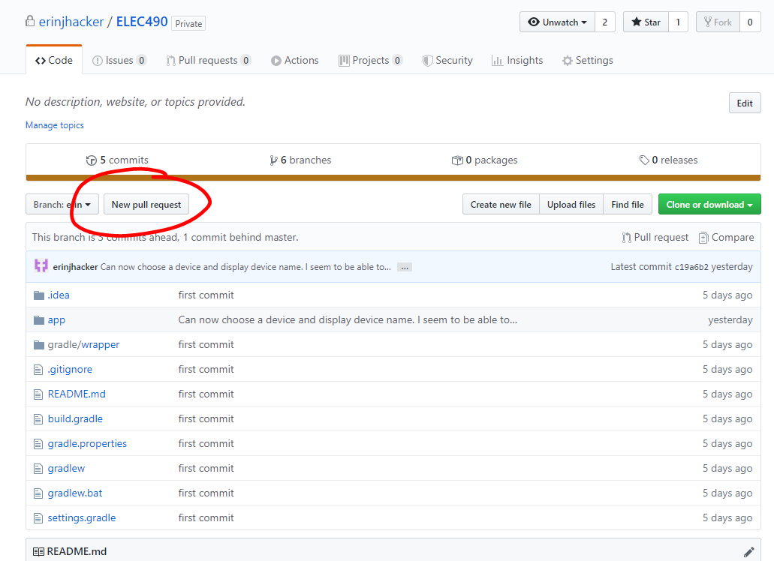
NOTE: DO NOT PUSH TO DEV – I’M TRUSTING YOU WITH THE INFORMATIONIN THE LAST SLIDE BUT YOU SHOULD ALWAYS HAVE SOMEONE PR YOUR CODE
Pull Requests
A “pull request” to push code?
Yes. Don’t question it.
After you push your branch to your local, go to github.com/erinjhacker/ELEC490/tree/<your_name>
Click “New pull request” then set it to merge into dev and assign it to someone else
This person must review your code – if it all looks gucci they can approve your PR and your code will be pushed into dev

Slide 9
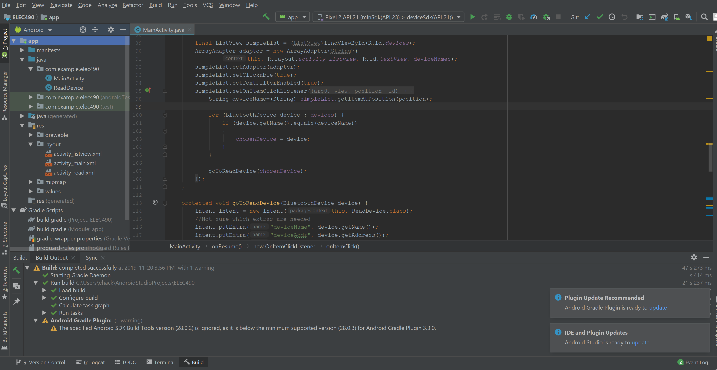
Android Studio for idiots (that’s you)
You can access all files through the bar on the left
All changes will be tracked in your local branch
Classes are where you actually do stuff
XML files are for the actual design of your app
Need to set the xml you want to use for each Java class
To set values, must set tags in both xml and Java code
AndroidManifest.xml and build.gradle are your settings for the project
Every class has multiple methods it must implement, several of which use @Override
Get these using Ctrl+I

Slide 10
Running your code
Can use emulator
Need to set up a virtual device to do so
Note that the virtual device can’t be used for Bluetooth, but it is helpful if you want to try clicking shit idk
Debug mode
Set breakpoints at lines of interest and click the little bug
When a breakpoint is hit, the code will stop and let you see what is currently stored in variables and other useful stuff
Can go into a method (F7), step over a breakpoint to the next line (F8), or continue to next breakpoint (F9)
Other option is to just run your code and see what happens

Slide 11
IDK let’s go through the code I have or something cause shit’s confusing

